Slide 1
Lesson 8 – Functional programming. Stream API

Slide 2
Lesson goals
Functional programming
Functional interface
Advanced lambda’s
java.util.Stream

Slide 3
Functional programming paradigm

Slide 4
Functional programming paradigm
Style of building the structure and elements of computer programs
Computation as the evaluation of mathematical functions;
Avoiding changing-state and mutable data;
Output value of a function depends only on the arguments that are input to the function;
Function with the same arguments always returns the same result;
Rely on the notion of deferred execution.

Slide 5
Lambda
Lambda – a piece of code
Anonymous class
Runnable r1 = new Runnable() {
@Override
public void run() {
System.out.print(“Hello");
}
};
Lambda
Runnable r2 = () -> {
System.out.print(“Hello");
};

Slide 6
Functional interface
one abstract method
unlimited count of default methods
unlimited count of static methods
unlimited count of private methods
can re-declare Object methods

Slide 7
Functional interface
@FunctionalInterface interface Speakable { String say(); }

Slide 8
Functional interface
@FunctionalInterface interface Speakable { String say();
static void someStatic() { System.out.println("In static..."); }
default void someDefault() { System.out.println("In default..."); }
private void somePrivate() { System.out.println("In private..."); } }

Slide 9
Lambda
parameter name
body
(Task val) -> {return val.execute();}
optional parameter type
required because in block
arrow

Slide 10
Lambda
1. s -> s.length()
2. (int a, int b) -> a + b
3. () -> 42
4. (x, y, z) -> {
if (x) {
return y;
} else {
return z;
}
}
Return is implicit and can be omitted
A lambda body is either a
single expression or a block

Slide 11
Lambda and Anonymous class difference
this keyword behavior is different
For an anonymous class, this keyword resolves to the anonymous class itself. For a lambda expression - class where the lambda is written.
Different compiled bytecode
Anonymous classes are compiled into inner classes. Lambda expressions are converted into private static (in some cases) methods of their enclosing class and, using the invoke dynamic instruction.

Slide 12
Lambda vs Anonymous class
@FunctionalInterface interface Translator { String translate(String input); }
public static void main(String[] args) { Translator oldSchool = new Translator() { @Override public String translate(String input) { return input.toLowerCase(); } }; Translator newSchool = input -> input.toLowerCase(); Translator newerSchool = String::toLowerCase; }

Slide 13
Accessibility
Lambda expressions can access
static variables
instance variables
effectively final method parameters
effectively final local variables
does not allow checked exceptions (if not declared)

Slide 14
Method reference
Sometimes, however, a lambda expression does nothing but call an existing method. In those cases, it's often clearer to refer to the existing method by name.
A method reference is the shorthand syntax to a lambda expression that executes just one method.

Slide 15
Method reference
Reference to a static method
AnimalFactory::newAnimal
Reference to an instance method of a particular object
zoo::addAnimal
Reference to an instance method of an arbitrary object of a particular type
Animal::getPawsCount
Reference to a constructor
Animal::new

Slide 16
Static method reference
class StudentUtils { public static boolean isGraduated(int num) { return num >= 60; } public static List<Integer> filterGraduated( List<Integer> scores,
Predicate<Integer> predicate
) { List<Integer> result = new ArrayList<>(); for (Integer i : scores) { if (p.test(i)) { result.add(i); } } return result; } }

Slide 17
Static method reference
List<Integer> list = Arrays.asList(12, 5, 55, 68, 40); List<Integer> result = filterGraduated(list, new Predicate<Integer>() { public boolean test(Integer score) { return StudentUtils.isGraduated(score); } });
List<Integer> result = filterGraduated(list, (i) -> StudentUtils.isGraduated(i)); List<Integer> result = filterGraduated(list, StudentUtils::isGraduated);

Slide 18
Reference instance method of an object
Mechanic mechanic = new Mechanic(); Car car = new Car(); execute(car, new Consumer<Car>() { public void accept(Car c) { mechanic.fix(c); } }); execute(car, c -> mechanic.fix(c)); execute(car, mechanic::fix);
static void execute(Car car, Consumer<Car> c) { c.accept(car); }
class Mechanic { void fix(Car c) {…} }
class Car { int id; //... }

Slide 19
Instance method of object of a particular type
class Shipment { double calculateWeight() {…} }
List<Shipment> l = new ArrayList<>();
calc(l, new Function<Shipment, Double>() { public Double apply(Shipment s) { // The object return s.calculateWeight(); // The method } });
calc(l, s -> s.calculateWeight());
calc(l, Shipment::calculateWeight);
static List<Double> calc(List<Shipment> l, Function<Shipment, Double> f) { List<Double> results = new ArrayList<>(); l.forEach(s -> results.add(f.apply(s))); return results; }

Slide 20
Reference to a constructor
Supplier<List<String>> s = new Supplier() { public List<String> get() { return new ArrayList<String>(); } }; List<String> l = s.get();
Supplier<List<String>> s = () -> new ArrayList<String>(); List<String> l = s.get();
Supplier<List<String>> s = ArrayList::new; List<String> l = s.get();

Slide 21
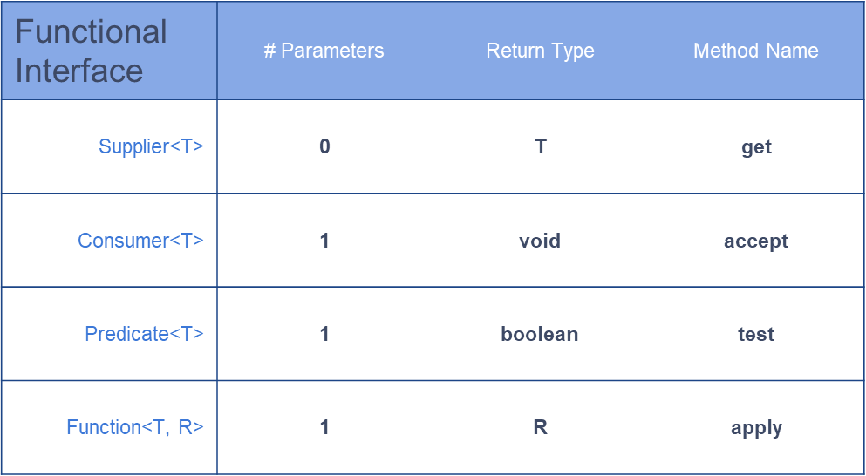
Common built-in functional interfaces

Slide 22
Supplier
@FunctionalInterface interface Supplier<T> { T get(); }
class Car { //... }
public static void main(String[] args) { Supplier<Car> suppl1 = () -> new Car(); Supplier<Car> suppl2 = Car::new; Supplier<Car> suppl3 = new Supplier<Car>() { @Override public Car get() { return new Car(); } };
println(suppl1.get()); //Car@26275bef println(suppl1.get()); //Car@7690781 println(suppl2.get()); //Car@77eca502 println(suppl2.get()); //Car@3246fb96 println(suppl3.get()); //Car@2e222612 println(suppl3.get()); //Car@61386958 println(suppl1);//Main$$Lambda$76/0x000000080012d840@73ee04c8 println(suppl2);//Main$$Lambda$77/0x000000080012dc40@7671cb68 println(suppl3);//Main$1@49dc7102 }

Slide 23
Consumer
@FunctionalInterface interface Consumer<T> { void accept(T t); }
class Car { //... }
public static void main(String[] args) { Supplier<Car> supplier1 = () -> new Car(); Supplier<Car> supplier2 = Car::new;
Consumer<Car> consumer1 = System.out::println; Consumer<Car> consumer2 = car -> System.out.print(car); consumer1.accept(supplier1.get()); //Car@14c966a consumer1.accept(supplier2.get()); //Car@14d3709 consumer2.accept(supplier1.get()); //Car@50df2e consumer2.accept(supplier2.get()); //Car@181eb93 }

Slide 24
Predicate
@FunctionalInterface interface Predicate<T> { boolean test(T t); }
class Car { //... boolean isElectric() { return false; } }
public static void main(String[] args) { Predicate<Car> predicate1 = car -> car.isElectric(); Predicate<Car> predicate2 = Car::isElectric; Supplier<Car> supplier = Car::new;
println(predicate1.test(supplier.get()));//false
println(predicate2.test(supplier.get()));//false }

Slide 25
Function
@FunctionalInterface interface Function<T, R> { R apply(T t); }
class Berry { //... }
class Jam { Jam(Berry berry) { // magic } }
public static void main(String[] args) {
Function<Berry,Jam> factory1 = Jam::new; Function<Berry,Jam> factory2 = berry -> new Jam(berry); println(factory1.apply(new Berry())); //Jam@1eba861 println(factory2.apply(new Berry())); //Jam@1480cf9 }

Slide 26
Stream API

Slide 27
Stream
Stream - a sequence of data (not data itself)
Stream pipeline - operations that run on a stream to produce a result
Finite and Infinite
Lazy evaluated
Not reusable

Slide 28
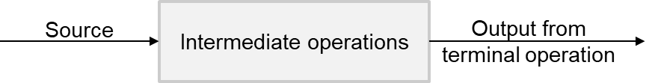
Stream parts
Source
Intermediate operations
Terminal operation

Slide 29
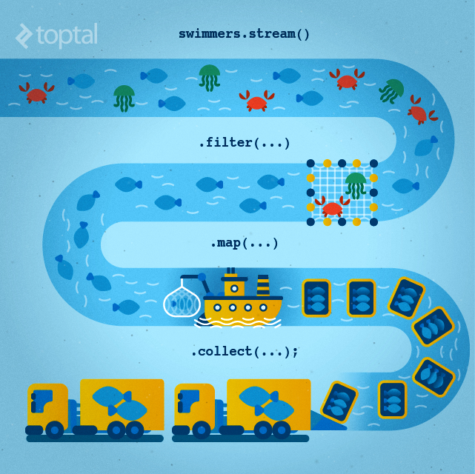
Stream parts

Slide 30
Stream parts
Collection<String> candidates = Arrays.asList("John","Simon","Julia","Robert");
List<String> saints = candidates.stream()
.filter(item -> item.startsWith("J")) .map(item -> "Saint ".concat(item)) .sorted((s1, s2) -> Integer.compare(s2.length(), s1.length())) .collect(Collectors.toList());
System.out.print(saints); // [Saint Julia, Saint John]

Slide 31
Stream creation
Stream<String> empty = Stream.empty();
Stream<Integer> singleElement = Stream.of(1,2);
Integer[] ints = {1,2,3}; Stream<Integer> fromArray = Stream.of(ints);
List<Integer> list = Arrays.asList(1, 2, 3, 4); Stream<Integer> fromList = list.stream();
Stream<String> fromListParallel = list.parallelStream();
Stream<Double> randoms = Stream.generate(Math::random);
Stream<Integer> oddNumbers = Stream.iterate(1, n -> n + 2).limit(10);

Slide 32
Stream intermediate operations
filter() - return a new stream that contains elements that match its predicate.
map() - transform the elements in a stream using the provided java.util.function.Function
flatMap() - transform each element into zero or more elements by a way of another stream
peek() - allows to peek into the stream before an action is encountered
distinct() - find unique elements in a stream according to their .equals() behavior.
sorted() - return a stream sorted according to natural order (or passed comparator)
limit() - limit the number or truncate elements to be processed in the stream
skip() - skip the start elements to be processed in the stream

Slide 33
Stream intermediate operations
Supplier<Stream<Integer>> numbers = () -> Stream.of(5, 4, 1, 3); numbers.get().filter(num -> num > 3).collect(toList()); // [5, 4] numbers.get().map(num -> num * 2).collect(toList()); // [10, 8, 2, 6] numbers.get().peek(System.out::println).collect(toList()); // [5, 4, 1, 3]
numbers.get().distinct().collect(toList()); // [5, 4, 1, 3]
numbers.get().sorted().collect(toList()); // [1, 3, 4, 5] numbers.get().limit(3).collect(toList()); // [5, 4, 1]
numbers.get().skip(2).collect(toList()); // [1, 3]

Slide 34
Stream terminal operations
allMatch() - check every element in the stream and find out if it matches the predicate
anyMatch() - find out whether at least one of the elements in the stream matches a given predicate.
noneMatch() - find if no elements in the stream match the specified predicate
collect() - convert the stream into some other container such as a list.
count() - find the number of elements in the stream
findAny() - find any element in a given stream.
findFirst() - find the first element in the stream
forEach() - perform an action for each element in the stream
min()/max() - find the minimum or maximum of a stream
reduce() - combine the stream elements into one using a BinaryOperator

Slide 35
Stream terminal operations
Supplier<Stream<Integer>> numbers = () -> Stream.of(5, 4, 1, 3); numbers.get().allMatch(n -> n > 0); // true
numbers.get().anyMatch(n -> n > 4); // true
numbers.get().noneMatch(n -> n > 0); // false
numbers.get().map(n -> n * n).collect(toList()); // [25, 16, 1, 9]
numbers.get().count(); // 4 numbers.get().findAny(); // Optional[5] numbers.get().findFirst(); // Optional[5] numbers.get().forEach(System.out::println); // 5 4 1 3
numbers.get().max(comparingInt(n -> n)); // Optional[5] numbers.get().reduce(0, (n1, n2) -> n1 + n2)); // Optional[13]

Slide 36
Stream order and parallel
Encounter order - the order in which the stream source makes it's elements available
Supplier<Stream<Integer>> s = () -> Stream.iterate(1, i -> i + 1).limit(10); s.get().forEach(System.out::print); // 12345678910 s.get().unordered().forEach(System.out::print); // 12345678910 s.get().parallel().forEach(System.out::print); // 78641032195 s.get().parallel().unordered().forEach(System.out::print); // 78109124365

Slide 37
Stream collectors
<R, A> R collect(Collector<? super T, A, R> collector)
<R> R collect(Supplier<R> supplier, BiConsumer<R, ? super T>
accumulator, BiConsumer<R,R> combiner)
Supplier<Stream<Character>> stream = () ->
Stream.of('w', 'o', 'l', 'f', '1', '3') .filter(Character::isLetter) .map(Character::toUpperCase);
stream.get().collect(Collectors.toList())); // [W, O, L, F]
stream.get().collect(StringBuilder::new, StringBuilder::append,
StringBuilder::append)); // WOLF

Slide 38
Stream, working with primitives
IntStream: Used for the primitive types int, short, byte, and char
LongStream: Used for the primitive type long
DoubleStream: Used for the primitive types double and float

Slide 39
Stream, working with primitives
OptionalDouble averageInteger = Stream.of(1.1, 2.6, 3.8) .mapToInt(Double::intValue) .average(); averageInteger.getAsDouble(); // 2.0
OptionalDouble averageInt = IntStream.of(1, 2, 3) .average(); averageInt.getAsDouble(); // 2.0

Slide 40
Stream, working with primitives
IntSummaryStatistics intSummaryStatistics = Stream.of(1, 2, 3) .mapToInt(integer -> integer) .summaryStatistics(); intSummaryStatistics.getMax(); // 3 intSummaryStatistics.getMin(); // 1 intSummaryStatistics.getSum(); // 6 intSummaryStatistics.getAverage(); // 2.0 intSummaryStatistics.getCount(); // 3

Slide 41
Stream methods (from/to) primitives
mapToInt()
mapToLong()
mapToDouble()
mapToObj()
sum()
average()
summaryStatistics()
boxed()

Slide 42
Homework

Slide 43
Homework
Compare performance of Stream API vs plain java;
Implement StudentsAnalyst feature;
Breaking the records problem from HackerRank.

Slide 44
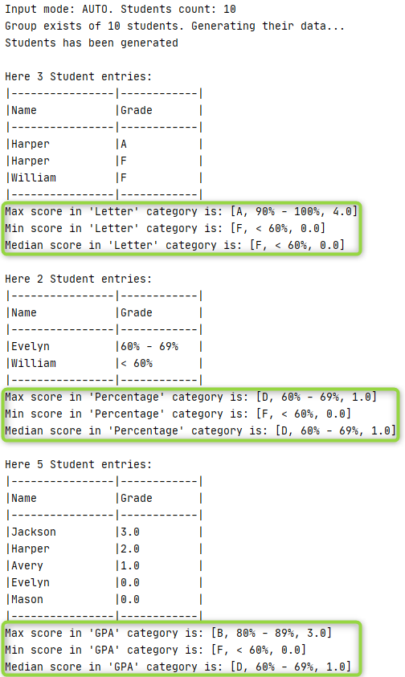
Homework
public interface StudentsAnalyst { Optional<Integer> averageScore(List<Student> students); Optional<Integer> maxScore(List<Student> students); Optional<Integer> minScore(List<Student> students); Optional<Integer> medianScore(List<Student> students); }

Slide 45
Links
“Clean Code: A Handbook of Agile Software Craftsmanship” by Robert C. Martin : Chapter 14-16
“Java: The Complete Reference” by Herbert Schildt (chapter 15, 29)
Lambda's (habr)
Lambda's best practices
Streams cheat sheet
Stream API (habr)

Slide 46
Thanks!
Any Questions?
Or find us in Slack:
@Yaroslav Brahinets
@Vasya Rudas

